Slide 1
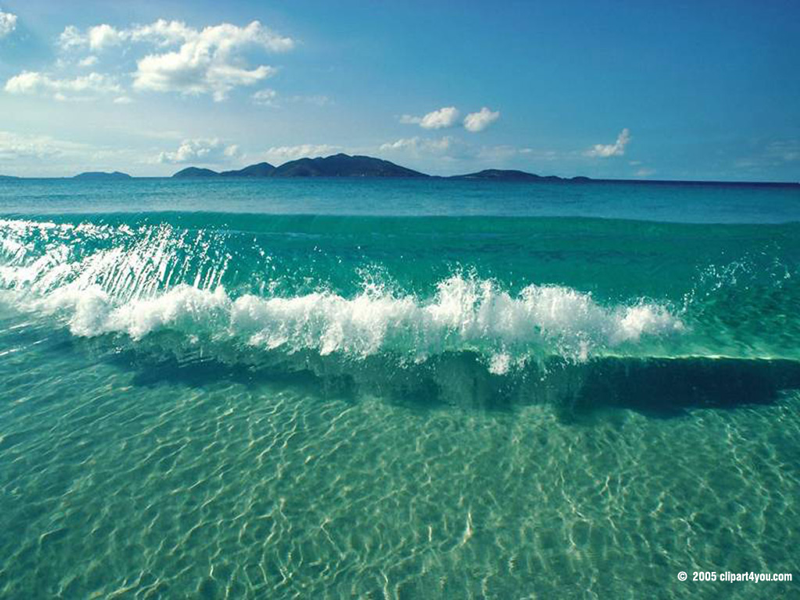
Ocean Energy

Slide 2
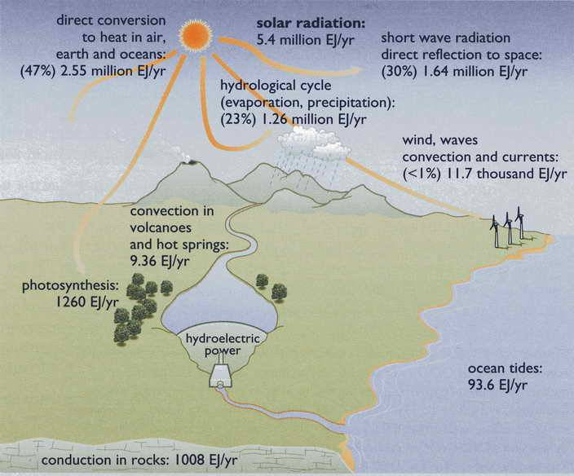
Sources of New Energy
Boyle, Renewable Energy, Oxford University Press (2004)

Slide 3
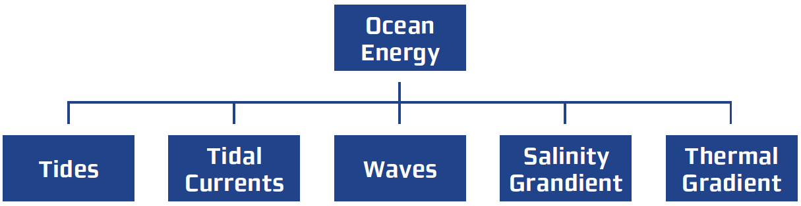
Renewable
Hydro Power
Wind Energy
Oceanic Energy
Solar Power
Geothermal
Biomass
Sustainable
Hydrogen & Fuel Cells
Nuclear
Fossil Fuel Innovation
Exotic Technologies
Integration
Distributed Generation
Which are not driven from solar energy???

Slide 4
Overview of Ocean Energy
ocean energy is replenished by the sun and through tidal influences of the
moon’s and sun’s gravitational forces
near-surface winds induce wave action and cause wind-blown currents at
about 3% of the wind speed
tides cause strong currents into and out of coastal basins and rivers
ocean surface heating by some 70% of the incoming sunlight adds to the
surface water thermal energy, causing expansion and flow
wind energy is stronger over the ocean due to less drag, although
technically, only seabreezes are from ocean energy

Slide 5
Hydro power – solar heating evaporates water from the surface of the oceans, form clouds, condenses as rain, falls over land, causes rivers to flows to feed dams that generate electricity
Wave energy – winds generate large ocean waves that can be used to generate power from its potential and kinetic energy.
Ocean temperature energy conversion (OTEC) – temperature gradient between the surface and bottom of the ocean can be utilized in a heat engine to generate power
Tidal energy – caused by lunar and solar gravitational forces acting together with that from the earth on the ocean waters to create tidal flows manifested by the rise and fall of waters that vary daily and seasonally from a few centimeters up to 8-10 meters in some parts of the world. The potential energy of the tides is tapped to generate power.
Table compiled from International Energy Agency, Policy Report, 2006

Slide 6
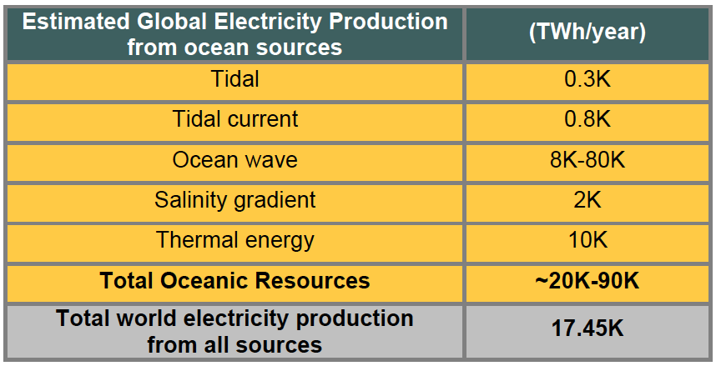
250 Billion barrels of oil worth of energy coming into ocean every day
80 million barrels of oil per day produced
World’s electricity consumption 17,000 TWh/yr
Table compiled from International Energy Agency, Policy Report, 2006

Slide 7
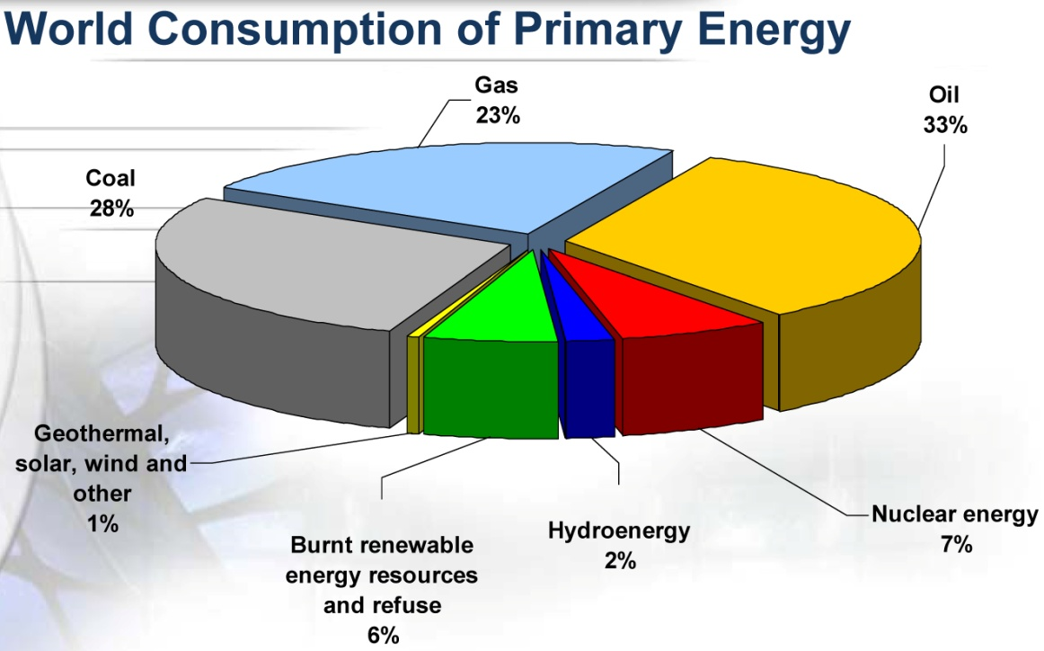
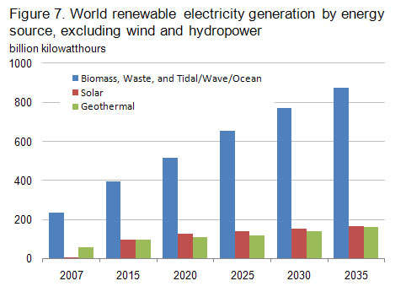
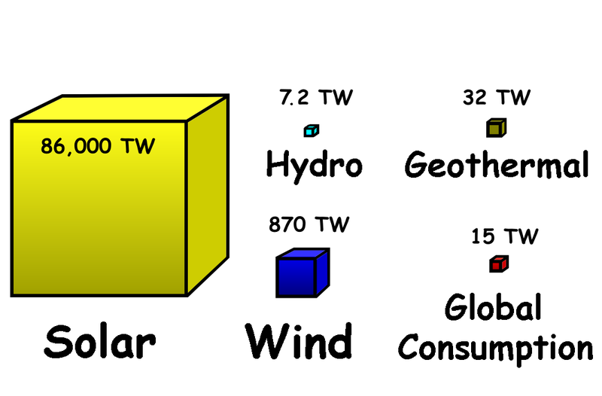
Introduction
Energy…
Present and Future
Federal Agency for Science and Innovation, 2008, Moscow, Russia

Slide 8
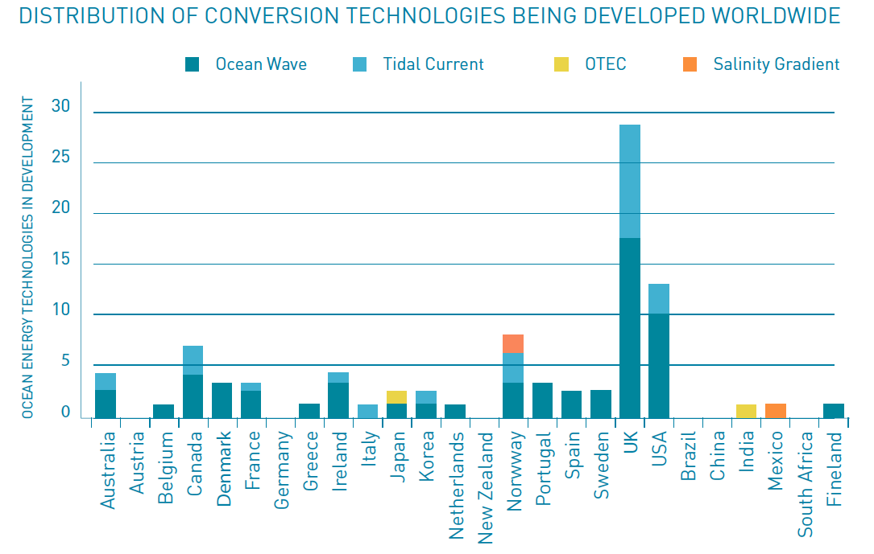
International Energy Agency, Policy Report, 2006

Slide 9
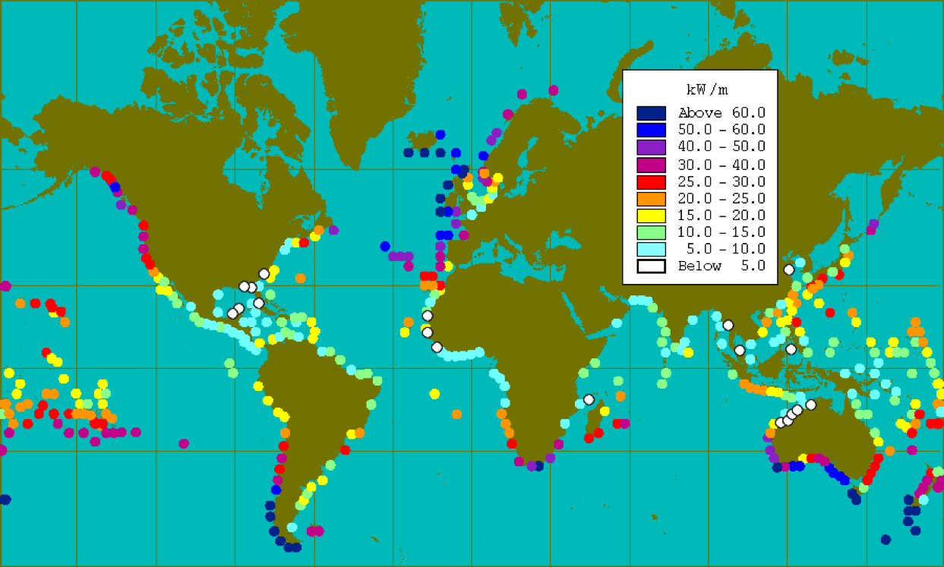
Power From Ocean Waves
Wave energy is strongest on the west coasts and increases toward the poles.
At approx. 30 kW/mcl in the Northwest (yearly avg.), a single meter (3.3 feet) of wave has the raw energy to power about 23 homes.

Slide 10
Why Ocean?
The ocean is the world's largest solar collector and can provide huge amount of energy (kinetic and thermal) which is absolutely clean (zero CO2 emission), sustainable, strategic, and predictable.
Changes in salinity, thermal gradients, tidal sea level change and currents, or ocean waves can be used to generate electricity.
The number of ocean energy technology concepts has increased to +100 known devices.
Available global Ocean Energy resource is in the same order of magnitude of the present electricity production worldwide (even more!).

Slide 11
Hydrokinetic vs. Hydropower
Tidal Power
Technologies
Environmental Impacts
Economics
Future Promise
Wave Energy
Technologies
Environmental Impacts
Economics
Future Promise
To understand ocean current energy, the distinction between hydropower and hydrokinetic power must be understood
“Hydropower”
Alters the environment to create useable energy from rivers and streams
“Hydrokinetic”
Harnesses the existing flow, current or velocity of water without altering the environment

Slide 12
Tidal Power

Slide 13
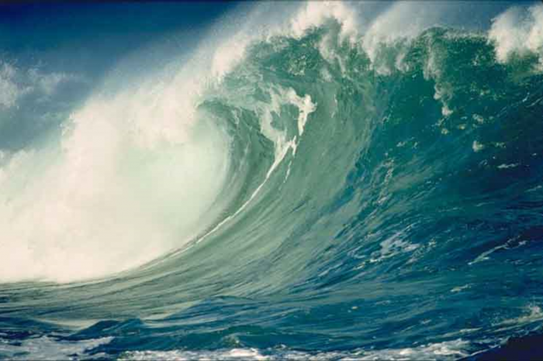
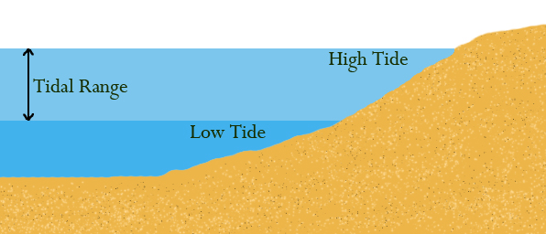
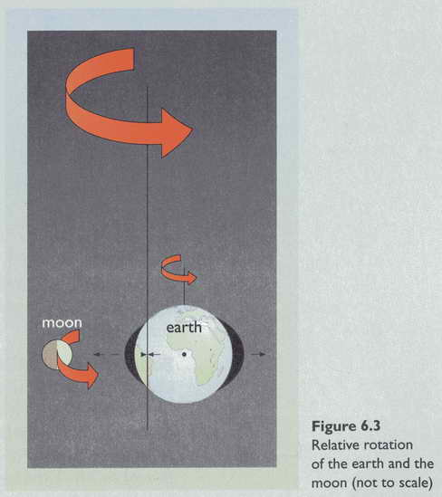
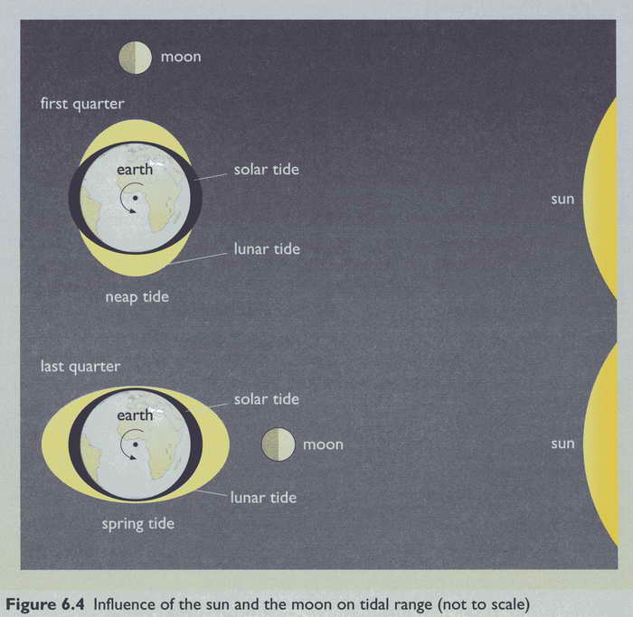
Tidal Motions
Tidal Forces
Boyle, Renewable Energy, Oxford University Press (2004)

Slide 14
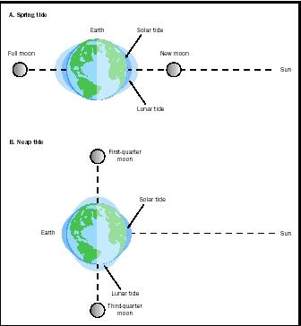
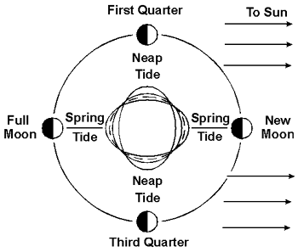
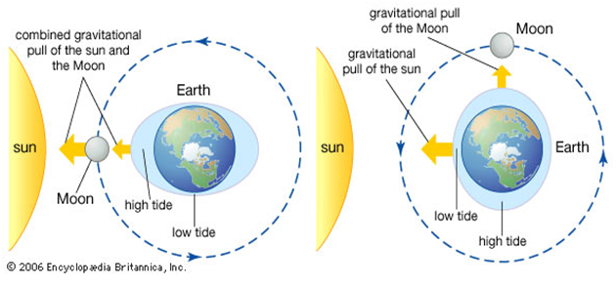

Slide 15
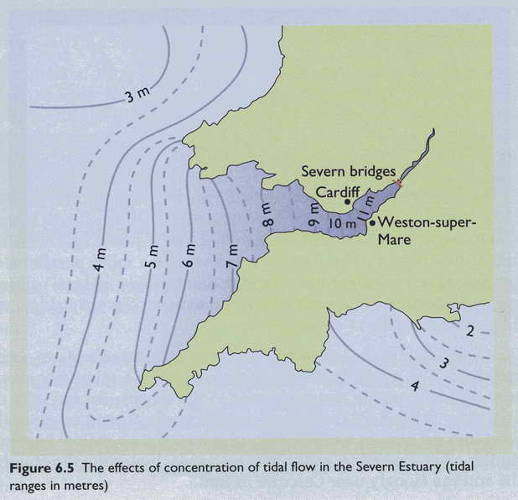
Natural Tidal Bottlenecks
Boyle, Renewable Energy, Oxford University Press (2004)

Slide 16
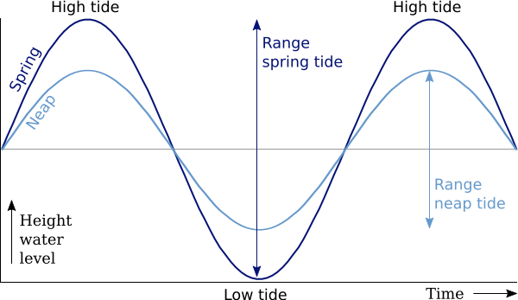
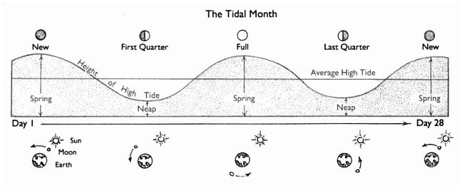

Slide 17
Tidal Energy Technologies
1. Tidal Turbine Farms
2. Tidal Barrages (dams)

Slide 18
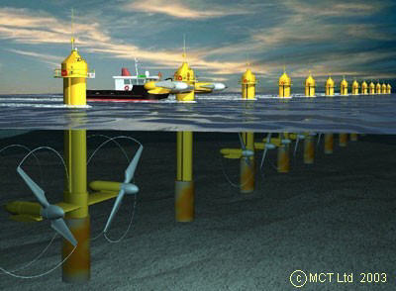
1. Tidal Turbine Farms

Slide 19
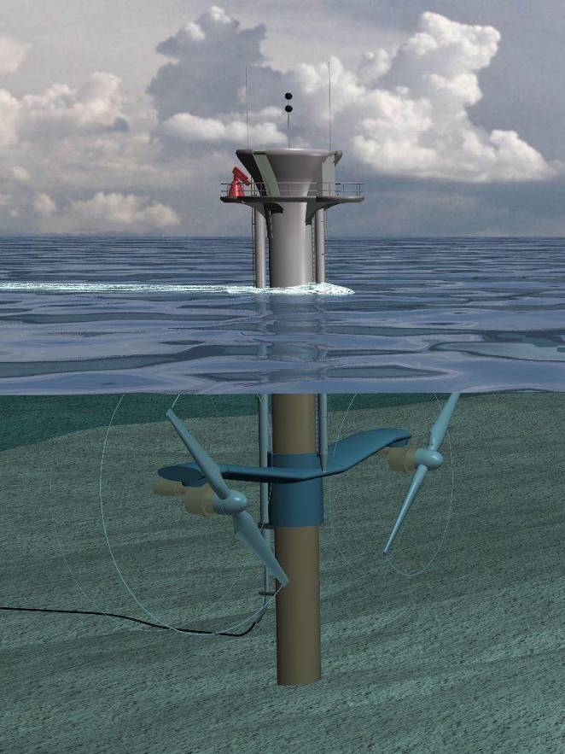
Tidal Turbines (MCT Seagen)
750 kW – 1.5 MW
15 – 20 m rotors
3 m monopile
10 – 20 RPM
Deployed in multi-unit farms or arrays
Like a wind farm, but
Water 800x denser than air
Smaller rotors
More closely spaced
MCT Seagen Pile
http://www.marineturbines.com/technical.htm
Notes:
Marine current turbines work, in principle, much like submerged windmills, but driven by flowing water rather than air. They can be installed in the sea at places with high tidal current velocities, or in a few places with fast enough continuous ocean currents, to take out energy from these huge volumes of flowing water. These flows have the major advantage of being an energy resource which is mostly as predictable as the tides that cause them, unlike wind or wave energy which respond to the more random quirks of the weather system. The technology under development by MCT consists of twin axial flow rotors of 15m to 20m in diameter, each driving a generator via a gearbox much like a hydro-electric turbine or a wind turbine. The twin power units of each system are mounted on wing-like extensions either side of a tubular steel monopile some 3m in diameter which is set into a hole drilled into the seabed.
The submerged turbines, which will generally be rated at from 750 to 1500kW per unit (depending on the local flow pattern and peak velocity), will be grouped in arrays or "farms" under the sea, at places with high currents, in much the same way that wind turbines in a wind farm are set out in rows to catch the wind. The main difference is that marine current turbines of a given power rating are smaller, (because water is 800 times denser than air) and they can be packed closer together (because tidal streams are normally bi-directional whereas wind tends to be multi-directional).
Environmental Impact Analyses completed by independent consultants have confirmed our belief that the technology does not offer any serious threat to fish or marine mammals. The rotors turn slowly (10 to 20 rpm) (a ship's propeller, by comparison, typically runs 10 times as fast and moreover our rotors stay in one place whereas some ships move much faster than sea creatures can swim). The risk of impact from our rotor blades is extremely small bearing in mind that virtually all marine creatures that choose to swim in areas with strong currents have excellent perceptive powers and agility, giving them the ability to successfully avoid collisions with static or slow-moving underwater obstructions.

Slide 20
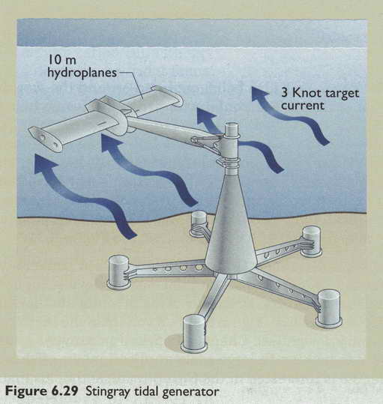
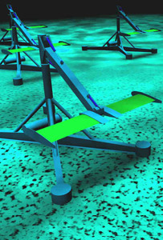
Oscillating Tidal Turbine
Oscillates up and down
150 kW prototype operational (2003)
Plans for 3 – 5 MW prototypes
http://www.engb.com
Boyle, Renewable Energy, Oxford University Press (2004)
Notes:
Stingray is designed to extract energy from water that flows due to tidal effects - tidal stream energy. It consists of a hydroplane which has its attack angle relative to the approaching water stream varied by a simple mechanism. This causes the supporting arm to oscillate which in turn forces hydraulic cylinders to extend and retract. This produces high pressure oil which is used to drive a generator.
http://www.engb.com

Slide 21
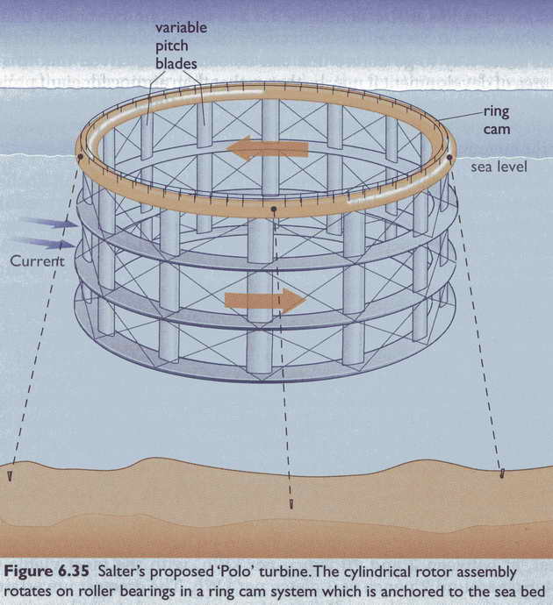
Polo Tidal Turbine
Vertical turbine blades
Rotates under a tethered ring
50 m in diameter
20 m deep
600 tonnes
Max power 12 MW
Boyle, Renewable Energy, Oxford University Press (2004)

Slide 22
Advantages of Tidal Turbines
Low Visual Impact
Mainly, if not totally submerged.
Low Noise Pollution
Sound levels transmitted are very low
High Predictability
Tides predicted years in advance, unlike wind
High Power Density
Much smaller turbines than wind turbines for the same power
http://ee4.swan.ac.uk/egormeja/index.htm

Slide 23
Disadvantages of Tidal Turbines
High maintenance costs
High power distribution costs
Somewhat limited upside capacity
Intermittent power generation

Slide 24
2. Tidal Barrage Schemes

Slide 25
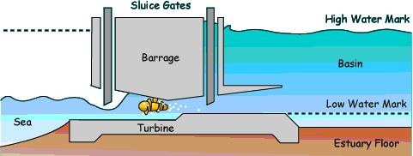
(Conventional) Tidal Energy
Technologies for harnessing energy from tides by building barrage across estuary are well developed, but this type of conversion process could have significant impact on local ecosystem.

Slide 26
Definitions
Barrage
An artificial dam to increase the depth of water for use in irrigation or navigation, or in this case, generating electricity.
Flood
The rise of the tide toward land (rising tide)
Ebb
The return of the tide to the sea (falling tide)

Slide 27
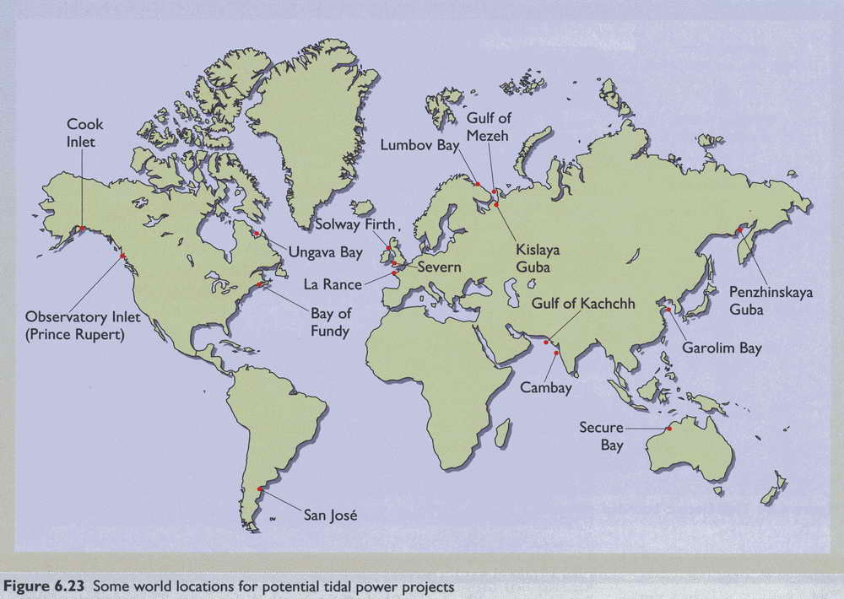
Potential Tidal Barrage Sites
Only about 20 sites in the world have been identified as possible tidal barrage stations
Boyle, Renewable Energy, Oxford University Press (2004)

Slide 28
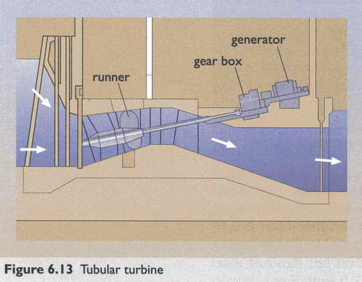
Tidal Barrage Tubular Turbine
Boyle, Renewable Energy, Oxford University Press (2004)

Slide 29
La Rance Tidal Power Barrage
Rance River estuary, Brittany (France)
Largest in world
Completed in 1966
24×10 MW bulb turbines (240 MW)
5.4 meter diameter
Capacity factor of ~40%
Maximum annual energy: 2.1 TWh
Realized annual energy: 840 GWh
Electric cost: 3.7¢/kWh
Boyle, Renewable Energy, Oxford University Press (2004)
Tester et al., Sustainable Energy, MIT Press, 2005

Slide 30
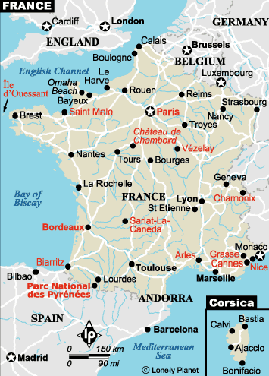
La Rance River, Saint Malo

Slide 31
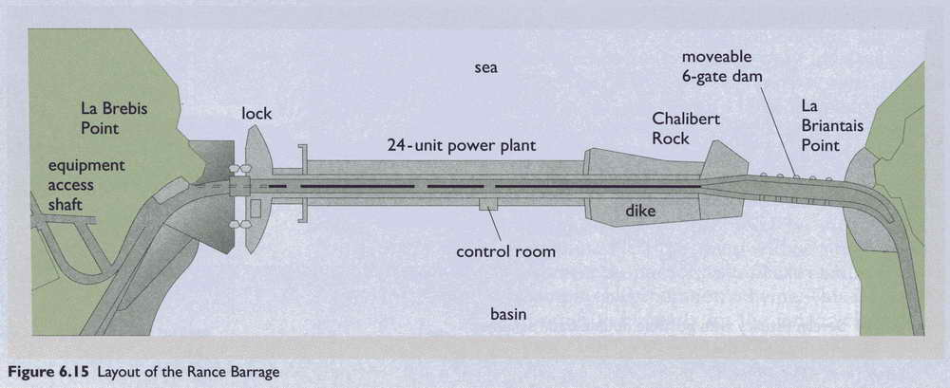
La Rance Barrage Schematic
Boyle, Renewable Energy, Oxford University Press (2004)

Slide 32
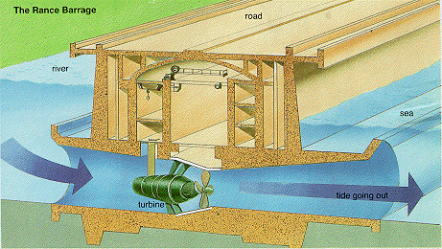
Cross Section of La Rance Barrage
http://www.calpoly.edu/~cm/studpage/nsmallco/clapper.htm

Slide 33
Tidal Barrage Energy Calculations
R = range (height) of tide (in m)
A = area of tidal pool (in km²)
m = mass of water
g = 9.81 m/s² = gravitational constant
= 1025 kg/m³ = density of seawater
≅ 0.33 = capacity factor (20-35%)
kWh per tidal cycle
Assuming 706 tidal cycles per year (12 hrs 24 min per cycle)
Average power
Tester et al., Sustainable Energy, MIT Press, 2005

Slide 34
La Rance Barrage Example
= 33%
R = 8.5 m
A = 22 km²
GWh/yr
Q. A simple single basin type tidal power plat has a
basin area of 22km² with a tide range of 10 m. The turbine
Stops when tide falls blow 3 m. calculate average power
generated during one filling emptying process if
efficiency is 74% and specific gravity of sea water is 1.025
Tester et al., Sustainable Energy, MIT Press, 2005

Slide 35
Wave Energy

Slide 36
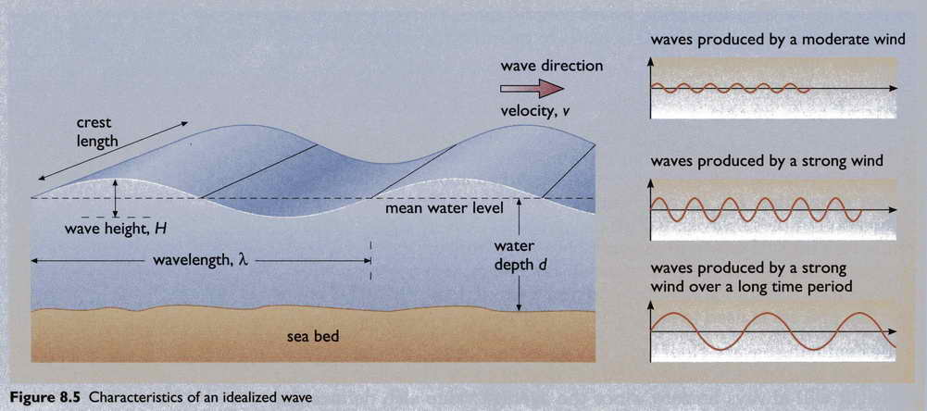
Wave Structure
Boyle, Renewable Energy, Oxford University Press (2004)

Slide 37
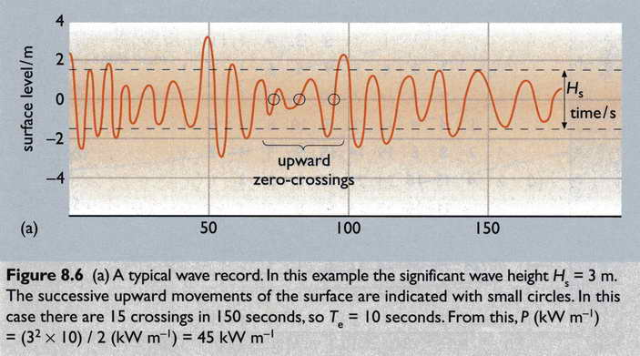
Wave Frequency and Amplitude
Boyle, Renewable Energy, Oxford University Press (2004)

Slide 38
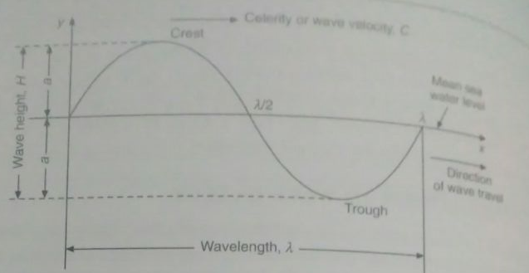
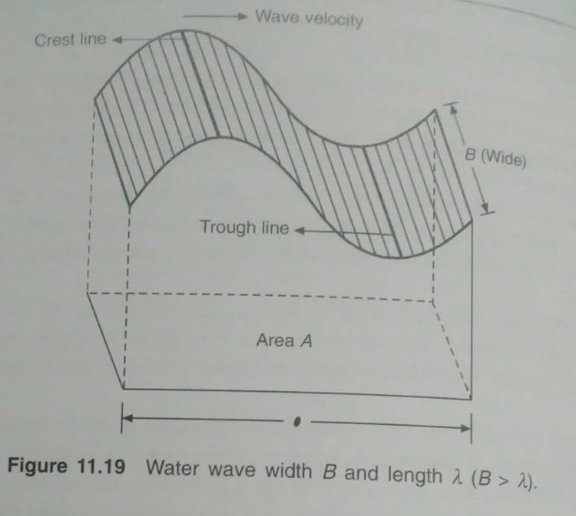
Wave Power Calculations
H=wave hight
A=amlpitude=H/2
T= time period=4-12 s
f=frequency
λ=wave length
Wave velocity C = λ/T
T =1/f
λ= 1.56 T ² m
P = Power in kW per meter of wave crest length
Example: H= 3m and T = 10s

Slide 39
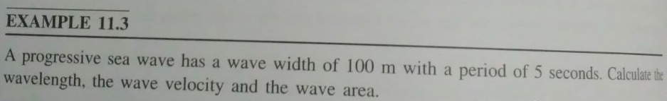
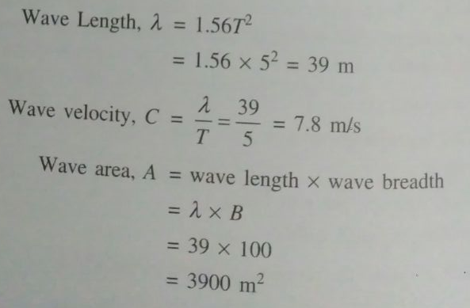

Slide 40
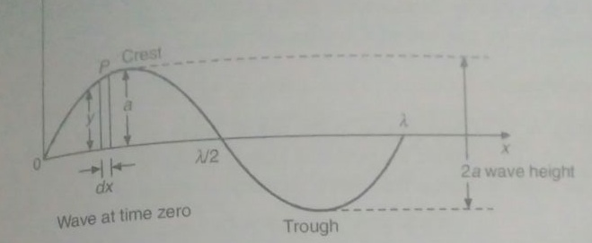
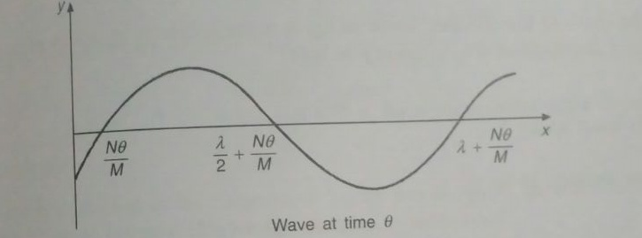

Slide 41
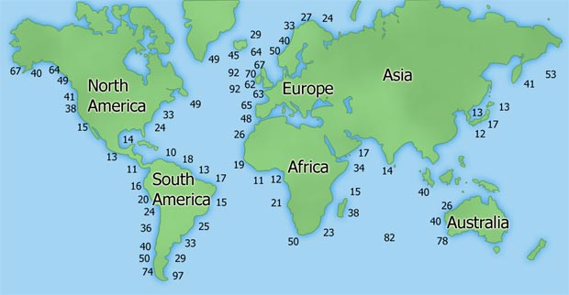
Global Wave Energy Averages
Average wave energy (est.) in kW/m (kW per meter of wave length)
http://www.wavedragon.net/technology/wave-energy.htm

Slide 42
Wave Energy Potential
Potential of 1,500 – 7,500 TWh/year
10 and 50% of the world’s yearly electricity demand
IEA (International Energy Agency)
200,000 MW installed wave and tidal energy power forecast by 2050
Power production of 6 TWh/y
Load factor of 0.35
DTI and Carbon Trust (UK)
“Independent of the different estimates the potential for a pollution free energy generation is enormous.”
http://www.wavedragon.net/technology/wave-energy.htm
Notes:
Potential world-wide wave energy contribution to the production of electricity is estimated by IEA (International Energy Agency) to be between 10 and 50% of the world’s yearly electricity demand of 15,000 TWh
A recent study by the DTI and Carbon Trust in UK is stating some 200,000 MW installed wave and tidal energy power by 2050 which with a load factor of 0.35 is resulting in a power production of 6 TWh/y. Independent of the different estimates the potential for a pollution free energy generation is enormous
http://www.wavedragon.net/technology/wave-energy.htm

Slide 43
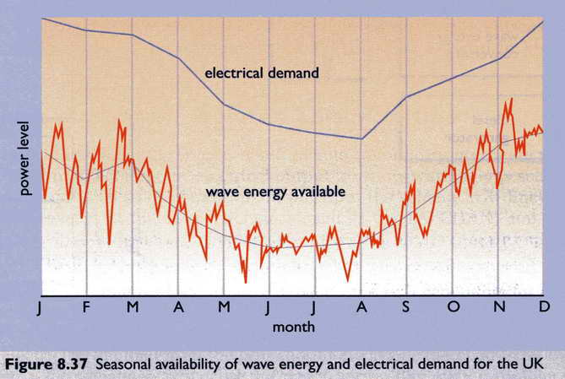
Wave Energy Supply vs. Electric Demand
Boyle, Renewable Energy, Oxford University Press (2004)

Slide 44
Wave Energy Environmental Impacts

Slide 45
Wave Energy Environmental Impact
Little chemical pollution
Little visual impact
Some hazard to shipping
No problem for migrating fish, marine life
Extract small fraction of overall wave energy
Little impact on coastlines
Release little CO₂, SO₂, and NO_{x}
11g, 0.03g, and 0.05g / kWh respectively
Boyle, Renewable Energy, Oxford University Press (2004)

Slide 46
Wave Energy Summary

Slide 47
Wave Power Advantages
Onshore wave energy systems can be incorporated into harbor walls and coastal protection
Reduce/share system costs
Providing dual use
Create calm sea space behind wave energy systems
Development of mariculture
Other commercial and recreational uses;
Long-term operational life time of plant
Non-polluting and inexhaustible supply of energy
http://www.oceansatlas.com/unatlas/uses/EnergyResources/Background/Wave/W2.html

Slide 48
Wave Power Disadvantages
High capital costs for initial construction
High maintenance costs
Wave energy is an intermittent resource
Requires favorable wave climate.
Investment of power transmission cables to shore
Degradation of scenic ocean front views
Interference with other uses of coastal and offshore areas
navigation, fishing, and recreation if not properly sited
Reduced wave heights may affect beach processes in the littoral zone
http://www.oceansatlas.com/unatlas/uses/EnergyResources/Background/Wave/W2.html
Notes:
High capital costs for initial construction [9] to resist exposure to strong wave forces, storms, and corrosion [10];
Wave energy is an intermittent resource [2];
Requires favorable wave climate. The highest concentration of wave energy occurs between the latitudes 40° and 60° in each hemisphere, which is where the winds blow most strongly. Latitudes of around 30° of the equator due to the regular trade winds may also be suitable for exploitation of wave energy [11];
Offshore wave energy systems require investment power transmission cables for electrical connections to shore [11];
Degradation of scenic ocean front views from wave energy devices located near or on the shore, and from onshore overhead electric transmission lines [10];
Potential interference with other uses of coastal and offshore areas such as navigation, fishing, and recreation if not properly sited [2];
By reducing the height of waves they may affect beach processes in the littoral zone [2].

Slide 49
Wave Energy Summary
Potential as significant power supply (1 TW)
Intermittence problems mitigated by integration with general energy supply system
Many different alternative designs
Complimentary to other renewable and conventional energy technologies
http://www.oceansatlas.com/unatlas/uses/EnergyResources/Background/Wave/W2.html
Notes:
Ocean waves have the potential to contribute up to one TW to the global energy supply.
The problems associated with the intermittence of wave energy can be smoothed by integration with the general energy supply system.
Many different wave power plants, some of them multi-purpose, have been proposed, assessed, and cost-estimated
With the development of large-scale demonstration and commercial power plants underway, wave energy will begin to play an increasing role in complementing other renewable and conventional energy technologies to meet global needs.

Slide 50
World Oceanic Energy Potentials (GW)
Source
Tides
Waves
Currents
OTEC¹
Salinity
World electric²
World hydro
Potential (est)
2,500 GW
2,700³
5,000
200,000
1,000,000
4,000
Practical (est)
20 GW
500
50
40
NPA⁴
2,800
550
¹ Temperature gradients
² As of 1998
³ Along coastlines
⁴ Not presently available
Tester et al., Sustainable Energy, MIT Press, 2005

